Slide 1
Positive Properties
of
Context-Free languages

Slide 2



Positive Properties of
Context-Free languages Union
Context-free languages
are closed under:
Union
is context free
is context free
is context-free

Slide 3
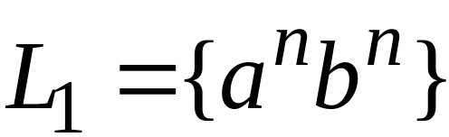
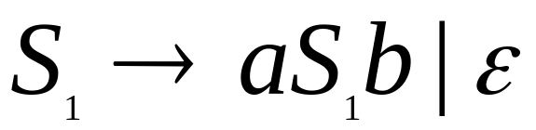
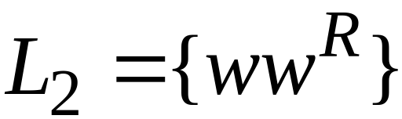
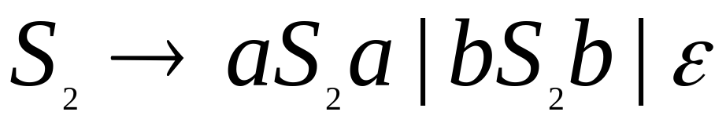
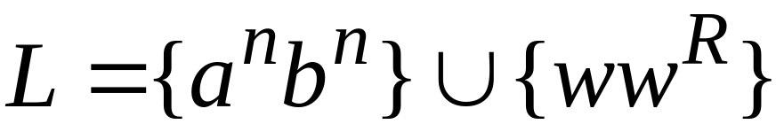

Example
Language
Grammar
Union

Slide 4
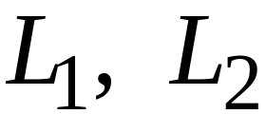
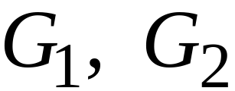
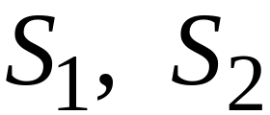

In general:
For context-free languages
with context-free grammars
and start variables
The grammar of the union
has new start variable
and additional production

Slide 5
Union Closure Properties 补充
Lemma: Let A₁ and A₂ be two CF languages,
then the union A₁∪A₂ is context free as well.
CFL对 并运算 封闭（还是中文精炼☺）
Proof 设 A1 对应与C语言函数bool M1(input);
A2 对应与C语言函数bool M2(input);
Bool M3(input )
{ A3= (M1(input) or M1(input) )
Return A3 ;
}
识别A1∪A2，显然M3只用了M1,M2类似的资源，
M3还是PDA, 所以A1∪A2是CFL

Slide 6

Concatenation
Context-free languages
are closed under:
Concatenation
is context free
is context free
is context-free

Slide 7

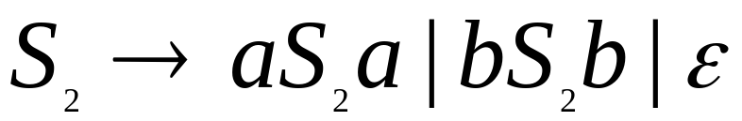
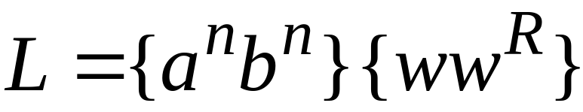
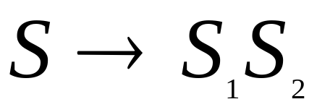
Example
Language
Grammar
Concatenation

Slide 8
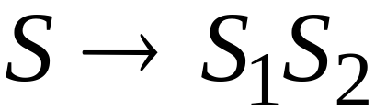
In general:
For context-free languages
with context-free grammars
and start variables
The grammar of the concatenation
has new start variable
and additional production

Slide 9


Star Operation
Context-free languages
are closed under:
Star-operation
is context free
is context-free

Slide 10
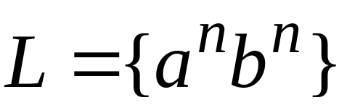
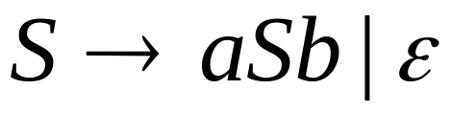
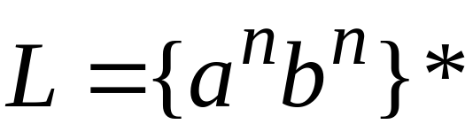
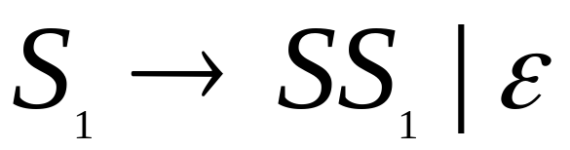
Example
Language
Grammar
Star Operation

Slide 11



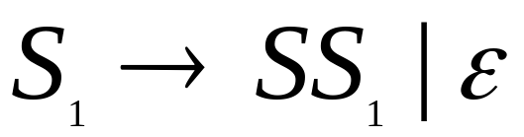
In general:
For context-free language
with context-free grammar
and start variable
The grammar of the star operation
has new start variable
and additional production

Slide 12
Negative Properties of
Context-Free Languages
Notes:
One proves this with specific counter examples of languages
直观解释：PDA资源不够多，记忆能力不够，不能作复杂集合(如CFL)的减法

Slide 13

Intersection
Context-free languages
are not closed under:
intersection
is context free
is context free
not necessarily
context-free

Slide 14
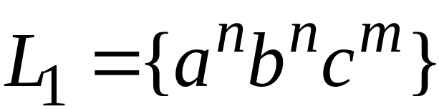
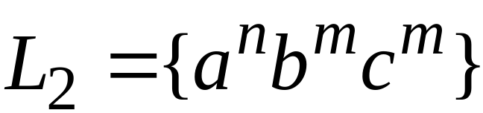
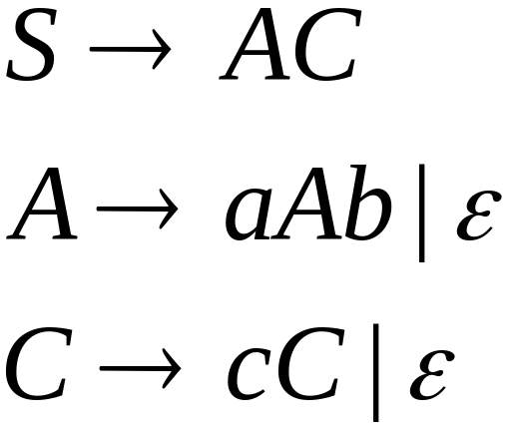
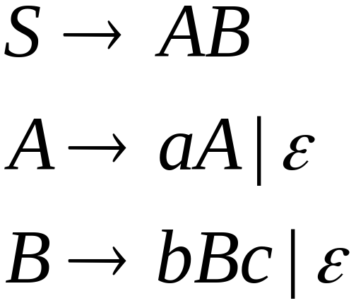
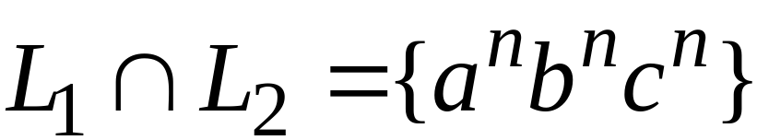
Example
Context-free:
Context-free:
Intersection
NOT context-free

Slide 15

Complement
Context-free languages
are not closed under:
complement
is context free
not necessarily
context-free

Slide 16


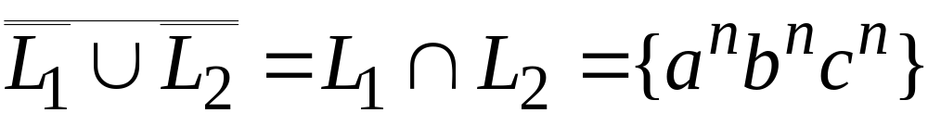
Example
Context-free:
Context-free:
Complement
NOT context-free

Slide 17
Applications of
Regular Closure

Slide 18
The intersection of
a context-free language and
a regular language
is a context-free language
Regular Closure
context free
regular
context-free

Slide 19



Machine
Machine
DFA
for
NPDA
for
regular
context-free
Construct a new NPDA machine
that accepts
simulates in parallel and

Slide 20
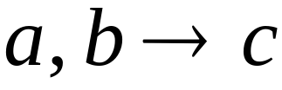




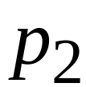
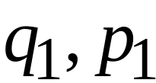
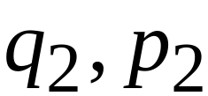
NPDA
DFA
transition
transition
NPDA
transition

Slide 21


NPDA
DFA
transition
NPDA
transition

Slide 22

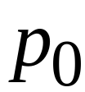
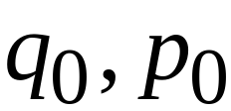
NPDA
DFA
initial state
initial state
NPDA
Initial state

Slide 23
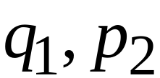
NPDA
DFA
final state
final states
NPDA
final states

Slide 24
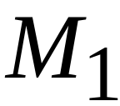









Example:
context-free
NPDA

Slide 25
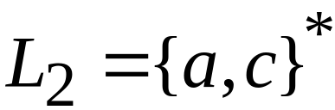
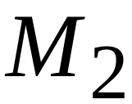


regular
DFA

Slide 26
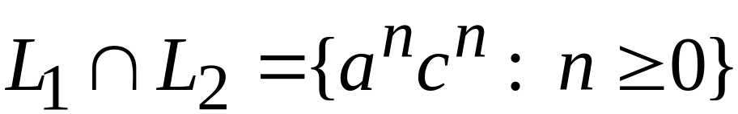





context-free
Automaton for:
NPDA

Slide 27


In General:
simulates in parallel and
accepts string
if and only if
accepts string and
accepts string

Slide 28
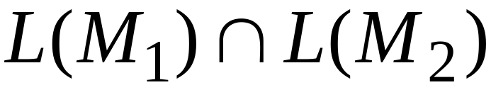
Therefore:
is NPDA
is context-free
is context-free

Slide 29
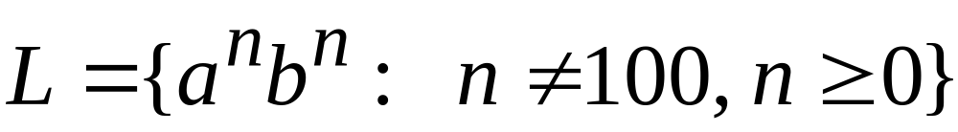
An Application of Regular Closure
Prove that:
is context-free

Slide 30

We know:
is context-free

Slide 31
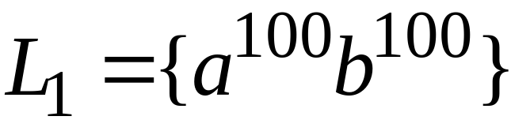
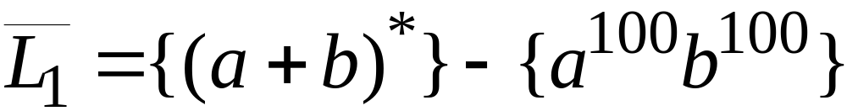
We also know:
is regular
is regular

Slide 32
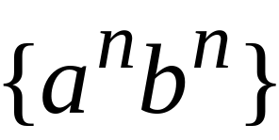
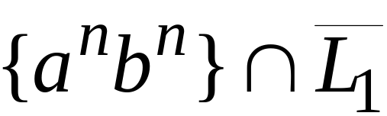
context-free
regular
(regular closure)
context-free
is context-free

Slide 33
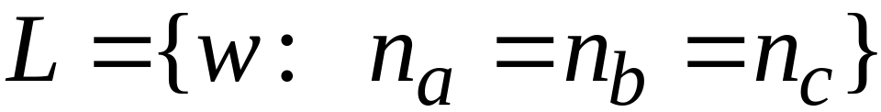
Another Application of Regular Closure
Prove that:
is not context-free

Slide 34
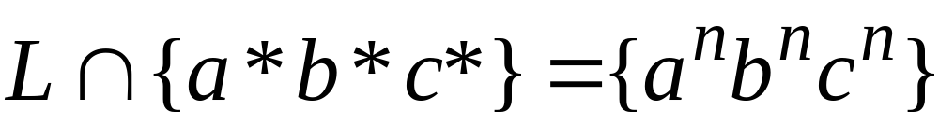
If
is context-free
(regular closure)
Then
context-free
regular
context-free
Impossible!!!
Therefore, is not context free

Slide 35
Deterministic PDAs - DPDAs

Slide 36
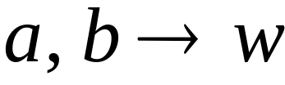


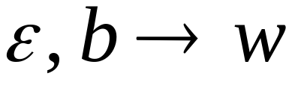
Deterministic PDA: DPDA
Allowed transitions:
(deterministic choices)
Notes:
Roughly speaking, a deterministic PDA is a PDA with only one choice at any time.

Slide 37
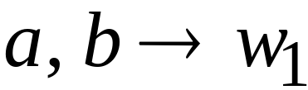
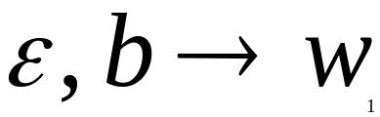
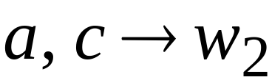
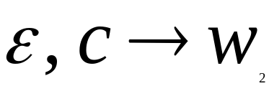

Allowed transitions:
(deterministic choices)

Slide 38
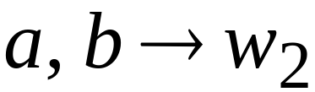
Not allowed:
(non deterministic choices)

Slide 39
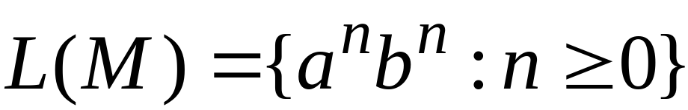





DPDA example

Slide 40

Definition:
A language is deterministic context-free
if there exists some DPDA that accepts it
Example:
The language
is deterministic context-free

Slide 41




Example of Non-DPDA (PDA)

Slide 42
Not allowed in DPDAs

Slide 43
PDAs
Have More Power than
DPDAs

Slide 44

It holds that:
Deterministic
Context-Free
Languages
(DPDA)
Context-Free
Languages
PDAs
Since every DPDA is also a PDA

Slide 45



We will actually show:
Deterministic
Context-Free
Languages
(DPDA)
Context-Free
Languages
(PDA)
We will show that there exists
a context-free language which is not
accepted by any DPDA

Slide 46


The language is:
We will show:
is context-free
is not deterministic context-free

Slide 47





Language is context-free
Context-free grammar for :

Slide 48
Theorem:
The language
is not deterministic context-free
(there is no DPDA that accepts )

Slide 49
Proof:
Assume for contradiction that
is deterministic context free
Therefore:
there is a DPDA that accepts

Slide 50




DPDA with
accepts
accepts

Slide 51
DPDA with
Such a path exists due to determinism

Slide 52



Fact 1:
The language
is not context-free
Context-free languages
Regular languages
(we will prove this at a later class using
pumping lemma for context-free languages)

Slide 53


Fact 2:
The language
is not context-free
(we can prove this using pumping lemma
for context-free languages)

Slide 54
We will construct a PDA that accepts:
which is a contradiction!

Slide 55







DPDA
Modify
Replace
with
DPDA

Slide 56








A PDA that accepts
Connect the final states of
with the final states of

Slide 57
Since is accepted by a PDA
it is context-free
Contradiction!
(since is not context-free)

Slide 58
Therefore:
Is not deterministic context free
There is no DPDA that accepts it
End of Proof

